Slide 1



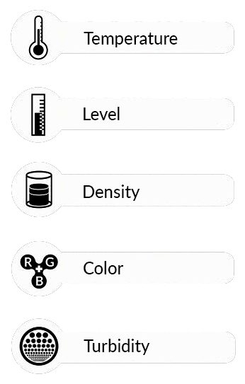






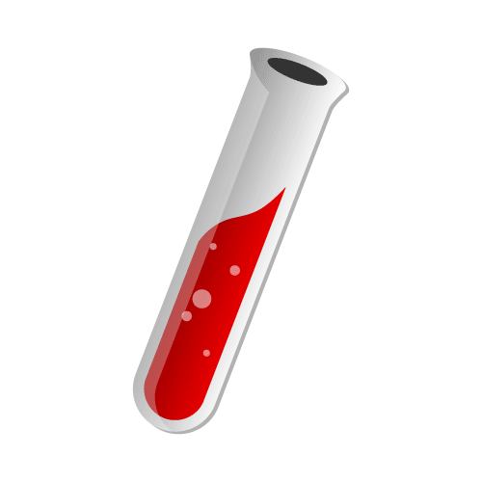
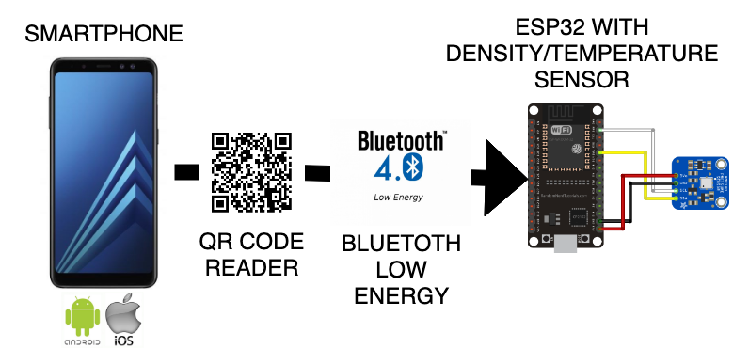
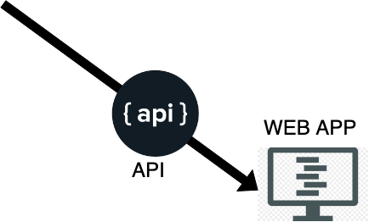
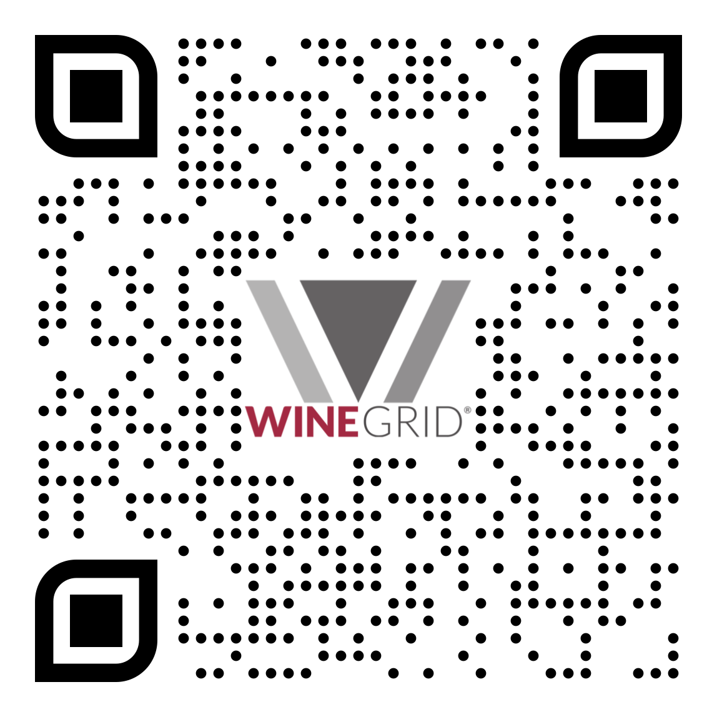
GROUP 01
Winegrid is a company that does real time vinification monitoring.
Monitoring the winemaking process manually is quite time and resource consuming.
Late reaction and lose monitoring, leads to lower wine quality, and therefore revenue loss.
Our goal is to access the data via Bluetooth Low Energy, with a Mobile Application (Android and iOS). Also perform some Data Analysis on the data collected from the sensors (normalization, prediction and confidence band).
Team
Rodrigo Rocha 71731
Rodrigo Oliveira 71860
Fábio Nunes 80109
João Jesus 80098
Diana Silva 80239
Susana Dias 80410
Mentors
Rogério Nogueira
Lúcia Bilro
Pedro Costa
Technologies Used
Winegrid goal is to bring the digital to the cellar, providing producers with real time, remote and reliable data of five main production variables, available in a dashboard via wifi.
Flutter
C++
Phyton
Jekyll
Visit our website for more information:
http://xcoa.av.it.pt/~pei2018-2019_g01/

